Slide 1
Unit 6: Internal Routing
6.1 Routing algorithms
Link state
Distance Vector
Hierarchical routing
6.2 Interior Gateway Routing
RIP
OSPF

Slide 2
Graph abstraction
5
v
3
w
2
5
u
2
1
z
3
1
2
x
y
1
Graph: G = (N,E)
N = set of routers = { u, v, w, x, y, z }
E = set of links ={ (u,v), (u,x), (v,x), (v,w), (x,w), (x,y), (w,y), (w,z), (y,z) }
Remark: Graph abstraction is useful in other network contexts
Example: P2P, where N is set of peers and E is set of TCP connections

Slide 3
Graph abstraction: costs
c(x,x’) = cost of link (x,x’)
- e.g., c(w,z) = 5
cost could always be 1, or
inversely related to bandwidth,
or related to congestion
(outgoing queue size in
routers)
5
v
3
w
2
5
u
2
1
z
3
1
2
x
y
1
Cost of path (x₁, x₂, x₃,…, x_{p}) = c(x₁,x₂) + c(x₂,x₃) + … + c(x_{p-1},x_{p})
Question: What’s the least-cost path between u and z ?
Routing algorithm: algorithm that finds least-cost path

Slide 4
Routing Algorithm classification (1)
Global or decentralized information?
Global:
all routers have complete topology, link cost info
“link state” algorithms
Decentralized:
router knows physically-connected neighbors, link costs to neighbors
iterative process of computation, exchange of info with neighbors
“distance vector” algorithms

Slide 5
Routing Algorithm classification (2)
Static or dynamic?
Static:
routes change slowly over time, often as a result of human intervention
fixes routes at boot time
useful only for simplest cases
Dynamic:
routes change more quickly
periodic update
in response to topology or link cost changes
table initialized at boot time
necessary in large internets

Slide 6
Routing Algorithm classification (3)
Load-sensitive or load-insensitive?
Load-sensitive:
Link costs vary dynamically to reflect congestion
A routing algorithm will tend to choose routes around the link with a high cost
e.g., early ARPAnet routing encountered many difficulties
Load-insensitive:
today's Internet routing algorithms
a link's cost does not explicitly reflect its current (or recent past) level of congestion
e.g., RIP, OSPF, BGP

Slide 7
Unit 6: Internal Routing
6.1 Routing algorithms
Link state
Distance Vector
Hierarchical routing
6.2 Interior Gateway Routing
RIP
OSPF

Slide 8
A Link-State Routing Algorithm
Dijkstra’s algorithm
net topology, link costs known to all nodes
accomplished via “link state broadcast”
all nodes have same info
computes least cost paths from one node (“source”) to all other nodes
gives forwarding table for that node
iterative: after k iterations, know least cost path to k dest.’s
Notation:
c(x,y): link cost from node x to y; = ∞ if not direct neighbors
D(v): current value of cost of path from source to dest. v
p(v): predecessor node along path from source to v
N': set of nodes whose least cost path definitively known

Slide 9
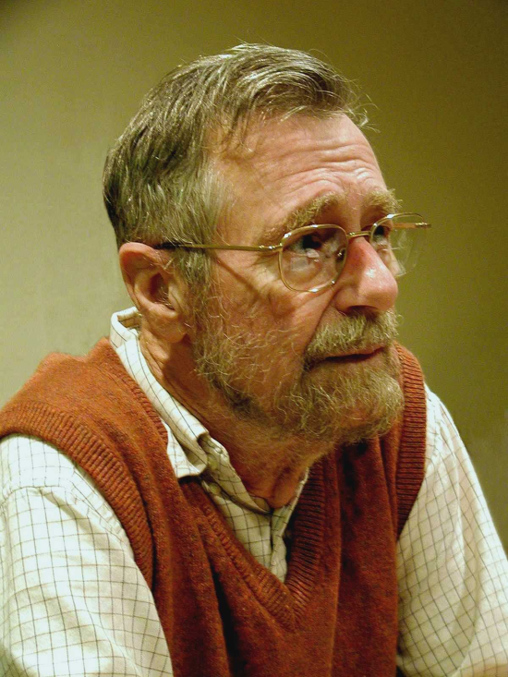
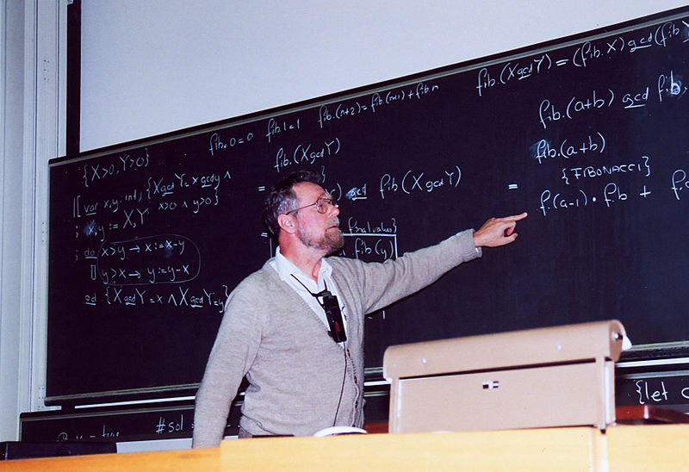
Dijkstra biography
Edsger Wybe Dijkstra (May 11, 1930 – August 6, 2002) was a Dutch computer scientist.
received the 1972 Turing Award for fundamental contributions to developing programming languages
was the Schlumberger Centennial Chair of Computer Sciences at The University of Texas at Austin from 1984 until 2000.
Dijkstra at the blackboard during a conference at ETH Zurich in 1994

Slide 10
Dijsktra’s Algorithm
1 Initialization:
2 N' = {u}
3 for all nodes v
4 if v adjacent to u
5 then D(v) = c(u,v)
6 else D(v) = ∞
7
8 Loop
9 find w not in N' such that D(w) is a minimum
10 add w to N'
11 update D(v) for all v adjacent to w and not in N' :
D(v) = min( D(v), D(w) + c(w,v) )
/* compare the cost of existing path to the one of the new path
Including the intermediate node w */
13 /* new cost to v is either old cost to v or known
14 shortest path cost to w plus cost from w to v */
15 until all nodes in N'

Slide 11
Dijkstra’s algorithm: example
Step
0
1
2
3
4
5
N'
u
ux
uxy
uxyv
uxyvw
uxyvwz
D(v),p(v)
2,u
2,u
2,u
D(w),p(w)
5,u
4,x
3,y
3,y
D(x),p(x)
1,u
D(y),p(y)
∞
2,x
D(z),p(z)
∞
∞
4,y
4,y
4,y
5
v
3
w
2
5
u
2
1
z
3
1
2
x
y
1

Slide 12
Dijkstra’s algorithm: example (2)
Resulting shortest-path tree from u:
v
w
u
z
x
y
Resulting forwarding table in u:
destination
link
v
(u,v)
x
(u,x)
y
(u,x)
w
(u,x)
z
(u,x)

Slide 13
Dijkstra’s algorithm, discussion (1)
Algorithm complexity: n nodes
each iteration: need to check all nodes, w, not in N’
n(n+1)/2 comparisons: O(n²)
more efficient implementations possible: O(nlogn)

Slide 14
Discussion (2): Pathology of Link State algorithm
Oscillations possible (with congestion-sensitive routing):
e.g., link cost = amount of carried traffic
=> link cost is asymmetric
i.e., c(u,v) = c(v,u) only if the load carried on both directions on the link (u,v) is the same
Dest.
Dest.
Dest.
Dest.
1
w
w
w
w
1+e
2+e
0
0
2+e
2+e
0
z
0
0
x
z
x
z
x
z
x
1+e
1
0
0
1+e
1
0
e
0
0
1
1+e
0
0
y
y
y
y
1
1
e
… recompute
Routing, x, y detect better path to w, clockwise
… recompute, x, y, z detect better path to w, counterclockwise
x, y, z detect better path to w, clockwise
initially
Notes:
pathology
英 [ pəˈθɒlədʒi ] 美 [ pəˈθɑ:lədʒi ]
GRE
n.病理（学） 〈比喻〉异常状态

Slide 15
Unit 6: Internal Routing
6.1 Routing algorithms
Link state
Distance Vector
Hierarchical routing
6.2 Interior Gateway Routing
RIP
OSPF

Slide 16
Distance Vector Algorithm
Bellman-Ford Equation (dynamic programming)
Define
d_{x}(y) := cost of least-cost path from x to y
Then
d_{x}(y) = min {c(x,v) + d_{v}(y) }
where min is taken over all neighbors v of x
This equation tries to find the best neighbor sitting on the least-cost path
The equation also says that the least-cost path concatenates the least-cost sub-paths
v

Slide 17
Bellman-Ford example
5
Clearly, d_{v}(z) = 5, d_{x}(z) = 3, d_{w}(z) = 3
v
3
w
2
5
u
z
B-F equation says:
2
1
3
1
2
d_{u}(z) = min { c(u,v) + d_{v}(z),
c(u,x) + d_{x}(z),
c(u,w) + d_{w}(z) }
= min {2 + 5,
1 + 3,
5 + 3} = 4
x
y
1
Node that achieves minimum is next
hop in shortest path ➜ forwarding table

Slide 18
Distance Vector Algorithm
D_{x}(y) = estimate of least cost from x to y
Node x knows cost to each neighbor v: c(x,v)
Node x maintains distance vector D_{x} = [D_{x}(y): y є N ]
Node x also maintains its neighbors’ distance vectors
For each neighbor v, x maintains D_{v} = [D_{v}(y): y є N ]

Slide 19
Distance vector algorithm (4)
Basic idea:
From time-to-time, each node sends its own distance vector estimate to neighbors
Asynchronous
When a node x receives new DV estimate from neighbor, it updates its own DV using B-F equation:
D_{x}(y) ← min_{v}{c(x,v) + D_{v}(y)} for each node y ∊ N
Under natural conditions, the estimate D_{x}(y) converge to the actual least cost d_{x}(y)

Slide 20
Distance Vector Algorithm (5)
Iterative:
each local iteration caused by:
local link cost change
DV update message from neighbor
Asynchronous:
does not require all nodes to operate in locksteps
Distributed:
each node notifies neighbors only when its DV changes
Convergence (self-terminating):
computation stops by itself
Each node:
wait for (change in local link cost or msg from neighbor)
recompute estimates
if DV to any dest has changed, notify neighbors

Slide 21
Distance Vector (DV) Algorithm
1 Initialization:
2 for all destinations y in N:
3 D_{x}(y) = c(x,y) /* if y is not a neighbor then c(x,y) = ∞ */
4 for each neighbor w
5 D_{w}(y) = ? for all destinations y in N
6 for each neighbor w
7 send distance vector D_{x} = [D_{x}(y): y in N] to w
8
9 loop
10 wait (until I see a link cost change to some neighbor w or
11 until I receive a distance vector from some neighbor w)
12
13 for each y in N:
14 D_{x}(y) = min_{v}{c(x,v) + D_{v}(y)}
15
16 if D_{x}(y) changed for any destination y
17 send distance vector D_{x} = [D_{x}(y): y in N] to all neighbors
18
19 forever
At each node, x

Slide 22
D_{x}(y) = min{c(x,y) + D_{y}(y), c(x,z) + D_{z}(y)} = min{2+0 , 7+1} = 2
D_{x}(z) = min{c(x,y) + D_{y}(z), c(x,z) + D_{z}(z)}
= min{2+1 , 7+0} = 3
Initially
node x table
cost to
cost to
x y z
x y z
x
0 2 7
x
0
2
3
y
y
y
from
∞
∞
∞
from
2 0 1
2
1
z
∞
∞
∞
z
7 1 0
x
z
node y table
7
cost to
x y z
The operation of the algorithm is illustrated in a sync. manner
The algorithm operates correctly in an async. manner as well
x
∞
∞
∞
2 0 1
y
from
z
∞
∞
∞
node z table
cost to
x y z
x
∞ ∞ ∞
y
from
∞
∞
∞
z
7
1
0
time

Slide 23
D_{x}(y) = min{c(x,y) + D_{y}(y), c(x,z) + D_{z}(y)} = min{2+0 , 7+1} = 2
D_{x}(z) = min{c(x,y) + D_{y}(z), c(x,z) + D_{z}(z)}
= min{2+1 , 7+0} = 3
node x table
cost to
cost to
cost to
x y z
x y z
x y z
x
0 2 7
x
0 2 3
x
0 2 3
y
y
y
from
∞
∞
∞
from
2 0 1
y
2
1
from
2 0 1
z
∞
∞
∞
z
7 1 0
z
x
z
3 1 0
node y table
7
cost to
cost to
cost to
x y z
x y z
x y z
The operation of the algorithm is illustrated in a sync. manner
The algorithm operates correctly in an async. manner as well
x
∞
∞
x
0 2 7
∞
2 0 1
x
0 2 3
y
y
from
from
2 0 1
y
from
2 0 1
z
∞
∞
∞
z
7 1 0
z
3 1 0
node z table
cost to
cost to
cost to
x y z
x y z
x y z
x
∞ ∞ ∞
x
0 2 7
x
0 2 3
y
y
y
from
2 0 1
from
2 0 1
from
∞
∞
∞
z
z
3 1 0
z
3 1 0
7
1
0
time

Slide 24
Distance Vector: link cost changes
Link cost changes:
node detects local link cost change
updates routing info, recalculates distance vector
if DV changes, notify neighbors
1
y
4
1
x
z
5
At time t₀, y detects the link-cost change, updates its DV,
and informs its neighbors.
“good
news
travels
fast”
At time t₁, z receives the update from y and updates its table.
It computes a new least cost to x and sends its neighbors its DV.
At time t₂, y receives z’s update and updates its distance table.
y’s least costs do not change and hence y does not send any
message to z.

Slide 25
node x table
cost to
cost to
cost to
x y z
x y z
x y z
x
0 4 5
x
0 1 2
x
0 1 2
y
y
from
4
0
1
from
1 0 1
y
from
1 0 1
z
5
1
0
z
5 1 0
z
2 1 0
node y table
cost to
cost to
cost to
x y z
x y z
x y z
1
x
4
5
x
0 4 5
y
0
1 0 1
x
0 1 2
y
y
4
1
from
from
1 0 1
y
from
1 0 1
x
z
z
5
1
0
z
5 1 0
z
2 1 0
5
node z table
cost to
cost to
cost to
x y z
x y z
x y z
x
0 4 5
x
0 4 5
x
0 1 2
y
y
y
from
1 0 1
from
1 0 1
from
4 0
1
z
z
2 1 0
z
2 1 0
5
1
0
time

Slide 26
Distance Vector: link cost changes
Link cost changes:
good news travels fast
bad news travels slow - “count to infinity” problem!
44 iterations before algorithm stabilizes: see text
Sol – poisoned reverse
If Z routes through Y to get to X :
Z tells Y its (Z’s) distance to X is infinite (so Y won’t route to X via Z)
will this completely solve count to infinity problem?
50
y
4
1
x
z
5
At time t0, Z says that it can go to x with cost 5 before y sends the update. Then y updates its distance vector with D_{y}(x) = 6.
At time t1, y sends its vector. Then z updates its vector with D_{z}(x) = 7.
After this ping-pong exchange 44 times, y and z will know the appropriate path to x

Slide 27
node x table
cost to
x y z
50
x
0 4 5
y
4
1
y
from
4
0
1
x
z
z
5
1
0
5
node y table
cost to
cost to
cost to
cost to
x y z
x y z
x y z
x y z
x
0 4 5
x
0 4 5
x
0 4 5
x
0 4 5
y
y
from
50
0
1
from
6
0
1
y
from
y
6
0
1
from
8
0
1
z
5
1
0
z
5
1
0
z
z
5
1
0
7
1
0
node z table
cost to
cost to
cost to
x y z
x y z
x y z
x
0 4 5
x
0 4 5
x
0 4 5
y
y
y
from
4
0
1
from
6
0
1
from
4
0
1
z
z
5
1
0
z
7
1
0
5
1
0
time

Slide 28
Comparison of LS and DV algorithms
Message complexity
LS: with n nodes, E links, O(nE) msgs sent
DV: exchange between neighbors only
convergence time varies
Speed of Convergence
LS: O(n²) algorithm requires O(nE) msgs
may have oscillations
DV: convergence time varies
may be routing loops
count-to-infinity problem
Robustness:
LS:
node can advertise incorrect link cost
each node computes only its own table
somewhat separated route calculations providing a degree of robustness.
DV:
DV node can advertise incorrect path cost
each node’s table used by others
error propagate thru network
Conclusion: Neither algorithm is an obvious winner over the other; indeed, both
algorithms are used in the Internet.

Slide 29
Unit 6: Internal Routing
6.1 Routing algorithms
Link state
Distance Vector
Hierarchical routing
6.2 Interior Gateway Routing
RIP
OSPF

Slide 30
Hierarchical Routing
Our routing study thus far - idealization
all routers identical
network “flat”
… not true in practice
scale: with 200 million destinations:
can’t store all dest’s in routing tables!
routing table exchange would swamp links!
administrative autonomy
internet = network of networks
each network admin may want to control routing in its own network
Some networks should not be passed through due to politics, economics, etc

Slide 31
Hierarchical Routing
aggregate routers into regions, “autonomous systems” (AS)
routers in same AS run same routing protocol
“intra-AS” routing protocol
routers in different AS can run different intra-AS routing protocol
Gateway router
Direct link to router in another AS

Slide 32
Interconnected ASes
3c
3a
2c
3b
2a
AS3
2b
1c
AS2
1a
1b
1d
AS1
forwarding table configured by both intra- and inter-AS routing algorithm
intra-AS sets entries for internal dests
inter-AS & intra-AS sets entries for external dests
Intra-AS
Routing
algorithm
Inter-AS
Routing
algorithm
Forwarding
table
A single router may use two different routing protocols simultaneously

Slide 33
Inter-AS tasks
AS1 must:
learn which dests are reachable through AS2, which through AS3
propagate this reachability info to all routers in AS1
Job of inter-AS routing!
suppose router in AS1 receives datagram destined outside of AS1:
router should forward packet to gateway router, but which one?
3c
3a
2c
3b
2a
AS3
2b
1c
AS2
1a
1b
1d
AS1

Slide 34
Unit 6: Internal Routing
6.1 Routing algorithms
Link state
Distance Vector
Hierarchical routing
6.2 Interior Gateway Routing
RIP
OSPF

Slide 35
Overview
Routing algorithm for wired networks where routers are not mobile
Routing protocol for unicast traffic
Intra-AS routing protocol
RIP : Distance Vector algorithm
OSPF: Link-state algorithm
Inter-AS routing protocol (hierarchical routing algorithm)
BGP : Distance Vector algorithm
Routing protocol for multicast traffic
MOSPF, DVMRP, PIM, CBT
Routing protocol for wireless Ad-hoc networks where routers are mobile
AODV, etc

Slide 36
Intra-AS Routing
also known as Interior Gateway Protocols (IGP)
most common Intra-AS routing protocols:
RIP: Routing Information Protocol
OSPF: Open Shortest Path First
IGRP: Interior Gateway Routing Protocol (Cisco proprietary)

Slide 37
Unit 6: Internal Routing
6.1 Routing algorithms
Link state
Distance Vector
Hierarchical routing
6.2 Interior Gateway Routing
RIP
OSPF

Slide 38
RIP ( Routing Information Protocol)
distance vector algorithm
included in BSD-UNIX Distribution in 1982
current standard is RIP2
a router is defined to be one hop from a directly connected network.
distance metric: # of hops (max = 15 hops)
From router A to subnets:
u
v
destination hops
u 1
v 2
w 2
x 3
y 3
z 2
A
B
w
x
z
C
D
y

Slide 39
RIP advertisements
distance vectors: exchanged among neighbors every 30 sec via Response Message (also called advertisement)
each advertisement: list of up to 25 destination subnets within AS

Slide 40
Two forms of RIP
Active
Form used by routers
Broadcasts routing updates periodically
Uses incoming messages to update routes
Passive
Form used by hosts
Uses incoming messages to update routes
Does not send updates

Slide 41
Slow convergence problem (count to infinity)
Normal situation
1 1 −
1 2 R₁
network 1
network 2
network 3
R₁
R₂
Failure
network1
network 2
network3
R₁
R₂
Sent just after the failure
~30 sec
1 2 R₁
1 16 −
1 3 R₂
1 4 R₁
1 5 R₂
…
…
1 16 R₁
time
1 16 R₂

Slide 42
RIP2 message format
Indicates what type of address is specified in this particular entry, e.g., IP address for 2
Attribute assigned to a route (e.g., ASN)
32 bits (4 byte)
specify the purpose of the datagram (an operation)
Address family identifier
Route tag
32 bits
IP address
COMMAND
VER.
Must be zero
Subnet mask
Next hop address
metric (1-16)
header
Routes’ part
Routing information
（20 bytes/route）
Max. 25 routes
RIP packet
IP
header
UDP
header
UDP segment
IP datagram

Slide 43
COMMAND field
Specifies an operation, only a few commands are used
Command | Meaning
1 | Request for partial or full routing information
2 | Response containing network-distance pairs from sender’s routing table
9 | Update request (used with demand circuits)
10 | Update response (used with demand circuits)
11 | Update acknowledge (used with demand circuits)

Slide 44
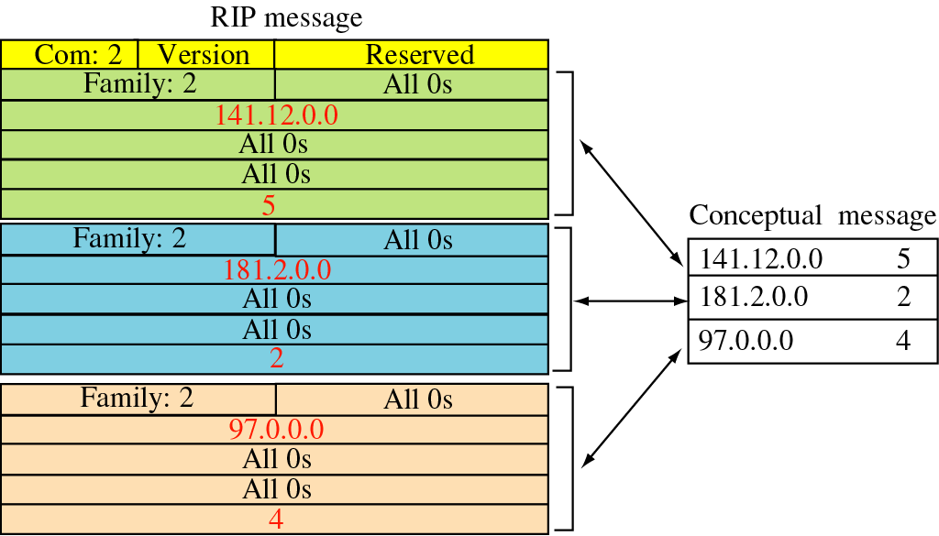
RIP response message

Slide 45
RIP Table processing
RIP routing tables managed by application-level process called route-d (daemon)
advertisements sent in UDP packets, periodically repeated
route-d
route-d
Transprt
(UDP)
Transprt
(UDP)
network forwarding
(IP) table
network
(IP)
forwarding
table
link
link
physical
physical

Slide 46
RIP: Example
z
w
x
y
A
D
B
C
Destination Network Next Router Num. of hops to dest.
w A 2
y B 2
z B 3
x -- 1
…. …. ....
Routing/Forwarding table in D

Slide 47
RIP: Example
Dest Next hops
w - 1
x - 1
z C 4
…. … ...
Advertisement
from A to D
z
w
x
y
A
D
B
C
Destination Network Next Router Num. of hops to dest.
w A 2
y B 2
z B A 7 5
x -- 1
…. …. ....
Routing/Forwarding table in D

Slide 48
RIP: Link Failure and Recovery
If no advertisement heard after 180 sec (i.e., 3 min) --> neighbor/link declared dead
routes via neighbor invalidated
new advertisements sent to neighbors
neighbors in turn send out new advertisements (if tables changed)
link failure info propagates to entire net
poison reverse used to prevent ping-pong loops (infinite distance = 16 hops)

Slide 49
Timers
Multiple timers for performance regulation
Each route contains the following timers.
Routing-update timer. –--- 30 Seconds
Every 30 seconds, the output process is instructed to generate a complete response to every neighboring router/gateway.
30 seconds updates are triggered by a clock not affected system load or service.
To prevent collisions – 30 second timer offset by addition of a small random time.
Time out timers. ---- 180 Seconds
Set route metric to 16 (Infinity); notify neighbors
Garbage collection timer. ---- 120 Seconds
Route is deleted from routing table; notify neighbors

Slide 50
Disadvantages of RIP hop counts
Hop counts provide a crude measure
does not always yield optimal routes with least delay or highest capacity
E.g., a path with hop count 3 crossing three Ethernets may be much faster than a path with hop count 2 crossing two satellite connections
makes relatively static routing (not respond to load changes)
Using RIP as an IGP limits routing in two ways
Hop-count metric
Limit on network span restricts the size of the internet
Neither a limit on the total number of routers nor a limit on density
Most campus networks have a small span (hierarchy topology)
The limit affects only large ASs that do not have a hierarchical organization

Slide 51
RIP2 - Disadvantages
supports generic notion of authentication, but only “password” is defined so far
→still not very secure
packet size increases as the number of networks increases
→not suitable for large networks
generates more protocol traffic than OSPF,
because it propagates routing information by periodically transmitting the entire routing table to neighbor routers
may be slow to adjust for link failures

Slide 52
Solution: OSPF within an AS
Can support fine-grained metrics (vs. RIP)
Multiple metrics
Throughput, Delay, Cost, Reliability
Can compute a different routing table for each metric.
OSPFv2 supports an extension that allows the metric to be used specified in the packet

Slide 53
Unit 6: Internal Routing
6.1 Routing algorithms
Link state
Distance Vector
Hierarchical routing
6.2 Interior Gateway Routing
RIP
OSPF

Slide 54
OSPF (Open Shortest Path First)
“open”: publicly available
vs. vendors’ proprietary protocols
uses Link State algorithm
LS packet dissemination
topology map at each node
route computation using Dijkstra’s algorithm
OSPF advertisement carries one entry per neighbor router
Permits hierarchical topology
advertisements disseminated to entire AS (via flooding)
carried in OSPF messages directly over IP (rather than TCP or UDP

Slide 55
OSPF Development History
CIDR
1987
1989
1991
1993
1995
1997
1999
OSPF Group formed
OSPFv2 published RFC 1247
Cryptographic authentication
OSPFv3 RFC 2740
Point-to-multipoint interfaces
OSPFv2 update RFC 2328
OSPFv1 published RFC 1131
MOSPF
OSPFv2 update RFC 2178
OSPFv2 update RFC 1583
Becomes recommended

Slide 56
OSPF Motivation
Original IGP used RIP
Based on Distance Vector Algorithm
Worked well in small systems
Hop count limit of 15
Suffered from problems of Distance Vector Protocol
Count to Infinity Problem
Slow Convergence
Large update packets
Slow response to topological changes
Need for a Link State Protocol

Slide 57
Functional Requirements of OSPF
Faster Convergence and less consumption of network resources
A more descriptive routing metric
Configurable
Value ranges between 1 and 65,535
No restriction on network diameters
Equal-cost multipath
A way to do load balancing
Routing Hierarchy
Support large routing domains
Separate internal and external routes
Support of flexible sub-netting schemes

Slide 58
OSPF “advanced” features (not in RIP)
security:
all OSPF messages authenticated using a variety of schemes (to prevent malicious intrusion)
load balancing across multiple paths,
i.e., multiple same-cost paths allowed (only one path in RIP)
type of service (TOS) routing
For each link, multiple cost metrics for different TOS (e.g., satellite link cost set “low” for best effort; high for real time)
integrated uni- and multicast support:
Multicast OSPF (MOSPF) uses same topology data base as OSPF
hierarchical OSPF in large domains, networks partitioned into subsets called areas
Each area is self-contained and hidden from outside

Slide 59
Hierarchical OSPF (1)
two-level hierarchy: local area, backbone.
Link-state advertisements only in area
each nodes has detailed area topology; only know direction (shortest path) to nets in other areas.
area border routers: “summarize” distances to nets in own area, advertise to other Area Border routers.
backbone routers: run OSPF routing limited to backbone.
boundary routers: connect to other AS’s.

Slide 60
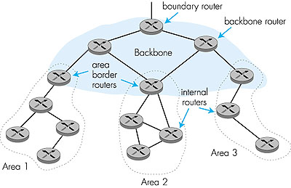
Hierarchical OSPF (2)
Backbone
Area1 Area2 Area3
AS1
Internal Routers
Area Border Routers
Backbone Routers
AS Border Routers

Slide 61
Two different areas
Distribution of link state advertisement (LSA) using reliable flooding, LSA flooding is bounded by area
Other AS
AS
Backbone 0.0.0.0
R₁
R₆
R₃
net 6
R₅
R₇
net 1
R₉
net 2
R₄
net 7
R₂
net 3
net 8
R₈
net 4
net 5
area 0.0.0.1
area 0.0.0.3
area 0.0.0.2

Slide 62
Reliable flooding
t₁
t₂
t₃
t₄
update
R
R
R
ACK
t
R

Slide 63
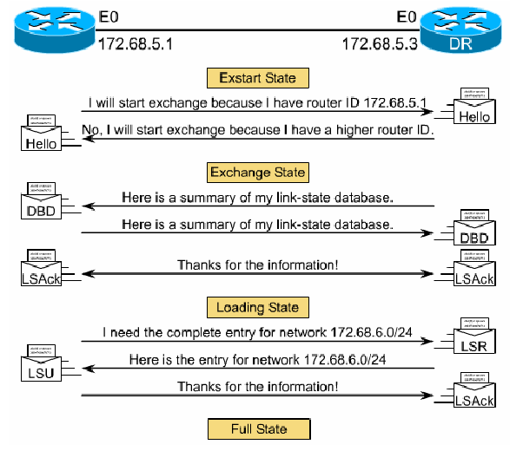
Discovering Routes and Reaching Full State
“adjacent”
Reachability
OSPF Type-1 (Hello)
OSPF Type-1 (Hello)
Database synchronization
OSPF Type-2 (DBD)
OSPF Type-2 (DBD)
OSPF Type-5 (LSAck)
New link state synch.
OSPF Type-3 (LSR)
OSPF Type-4 (LSU)
OSPF Type-5 (LSAck)

Slide 64
Fixed 24-byte OSPF message header
bit
0
8
16
31
version
type
message length
Source router IP address
Area ID
checksum
Authentication type
authentication
authentication
24 bytes
OSPF header
Type 1-5 OSPF messages
IP header
OSPF message
IP packet

Slide 65
OSPF message types
Type | Meaning
1 | Hello (used to test reachability)
2 | Database description (topology)
3 | Link status request
4 | Link status update
5 | Link status acknowledgement

Slide 66
OSPF Operation
Establishing router adjacencies (which are neighbors with two way communication)
Electing DR (designated router) and BDR (backup designated router) – represent routers in one area
Discovering Routes (get link states by exchanging)
Choosing Routes – Shortest Path First (SPF) algorithm
Maintaining Routing Information

Slide 67
OSPF Basics
Distributed, replicated database model
Each router builds a topology database
Describes complete routing topology
Link state database
Identical for all the routers
LSA: Link State Advertisements
Information about adjacencies sent to all routers

Slide 68
OSPF Basics (Cont.)
A "shortest path" algorithm is used to find best route (dijsktra)
Converge as quickly as databases can be updated
Every router calculate itself routing table independently

Slide 69
OSPF Basics (Cont.)
OSPF has 3 sub-protocols:
Hello protocol
Exchange protocol
Flooding protocol
Destination IP address: Neighbors IP address or AllOSPFRouters (224.0.0.5) or AllDRouters (224.0.0.6)

Slide 70
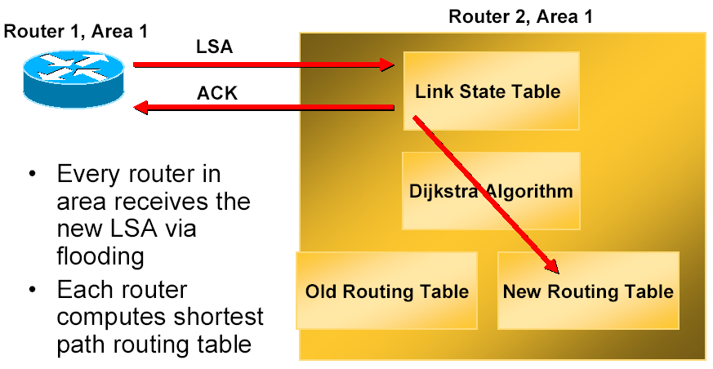
Maintaining routes
When a Link Changes State

Slide 71
Scaling OSPF
Rule of thumb
no more than 150 routers /area
Reality
no more than 500 routers/area
Backbone area is an area that glue all the other areas
always marked as area 0
proper use of areas reduces bandwidth
summarized routes
instability is limited within the area

Slide 72
OSPF Summary
Why OSPF is needed in the Internet?
The basics of the protocol
The operation of the protocol
Neighbor Discovery (Hello Protocol)
The Link state Advertisements
Database Synchronization and reliable flooding
Hierarchical Routing in OSPF
OSPF Areas and Area Organization

Slide 73

Homework 1
Compare and contrast link-state and distance-vector routing algorithms

Slide 74
Homework 2
Comparison between RIP and OSPF

Slide 75
Homework 3
Describe a pathology of link-state algorithm (oscillations) and give your understanding.

Slide 76
Homework 4
Describe the “count-to-infinity” problem of the DV algorithm and give your understanding.

Slide 77
Homework 5
Describe the concept of “poisoned reverse”.

Slide 78
Homework 6
Give a detailed description about RIP disadvantages.

